Slide 1
Cape Cod Regional Technical High School
“Not Your Mother or Father’s Vocational School”
Superintendent/Director
Bob Sanborn

Slide 2
Agenda
Who are we?
What are our goals?
What are our accomplishments and challenges?
How can we collaborate for our mutual benefit?
What is the curriculum of our information technologies technical area?
Questions and answers in both directions

Slide 3
Who are we?
A regional technical high school AND a district
A $12,781,986 operation (FY12 Budget, 2.56 % increase)
A school under all the mandates as a comprehensive school for MCAS, NCLB and ultimately RTTT performance while still providing first class technical training
A school serving a student population that is over 30 % special needs
A school that sends over 40% of our students to further education and training

Slide 4
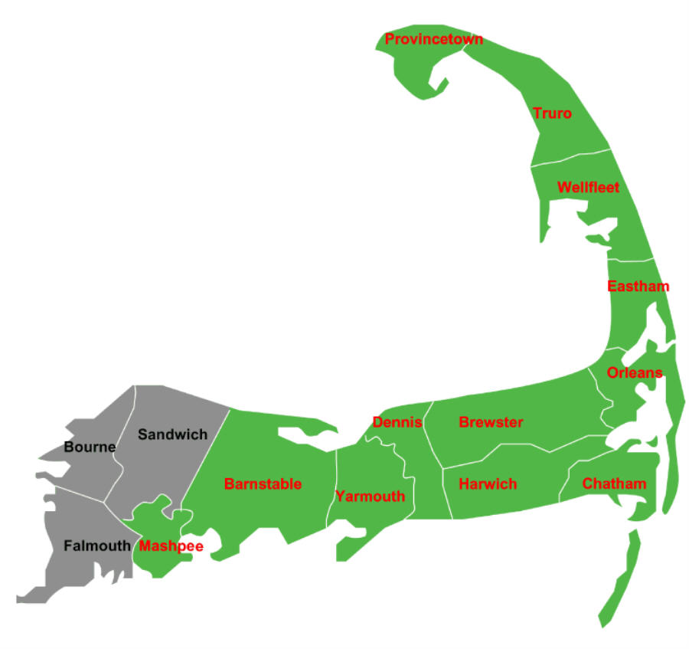
We are a District
comprised of 12 sending towns with
692 students
Provincetown
5 Students
Truro
6 Students
Wellfleet
6 Students
Eastham
12 Students
Dennis
98 Students
Brewster
45 Students
Barnstable
183 Students
Orleans
18 Students
Cape Tech
Chatham
18 Students
Harwich
68 Students
Mashpee
67 Students
Yarmouth
166 Students
Student enrollment as of October 1, 2010

Slide 5
WE are Governed & Organized as shown:
Executive Sub-Committee
School Committee:
Twenty-four members:
two from each of the sending towns
Finance Sub- Committee
Curriculum Sub-Committee
Facilities Sub-Committee
Equipment Sub-Committee
Negotiations Sub-Committee
Safety & Security Sub-Committee
Business Manager
Superintendent
Parent School Council
Curriculum Coordinator
Technology Coordinator
Principal
Student Council
Director of Pupil Services
Technical Studies Director
Dean of Students
FACULTY
Technical Advisory Committees

Slide 6
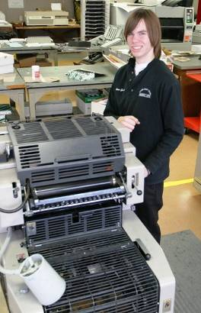
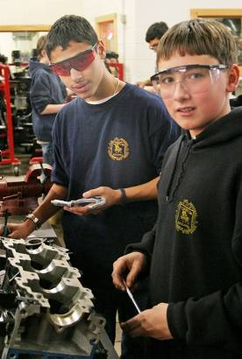
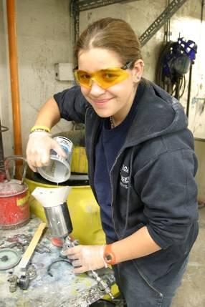
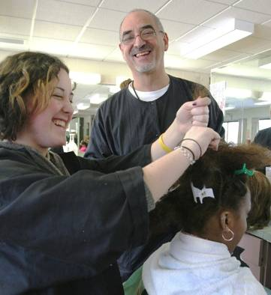
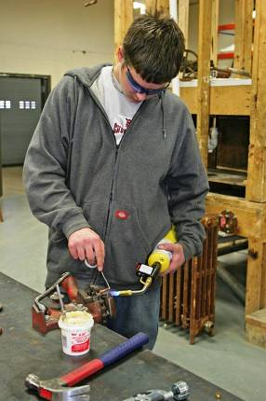
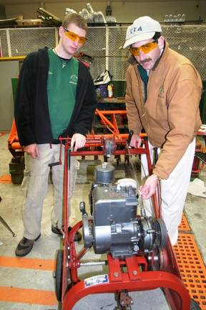
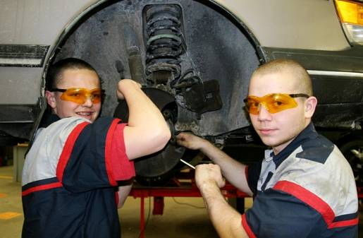
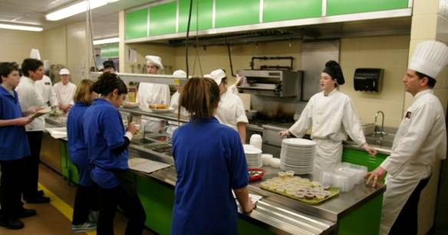
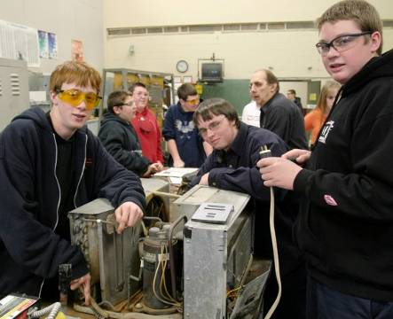
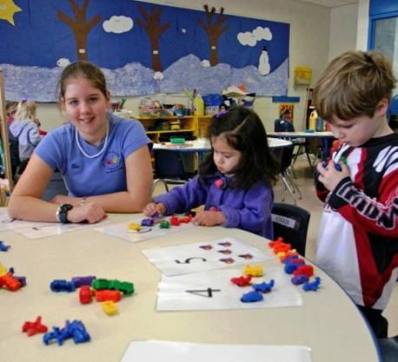
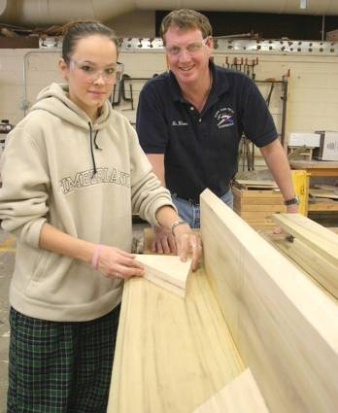
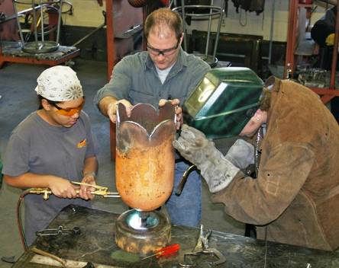
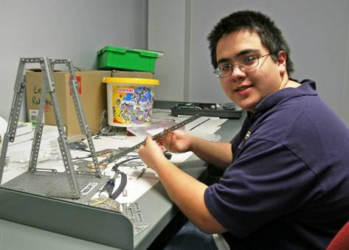
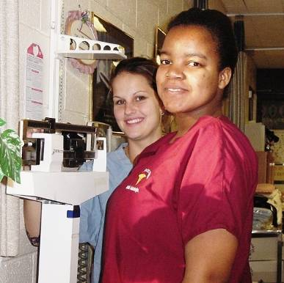
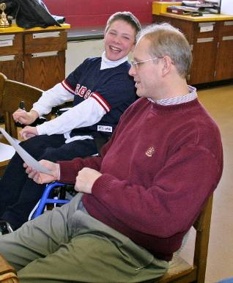
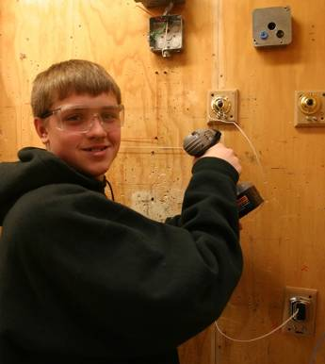
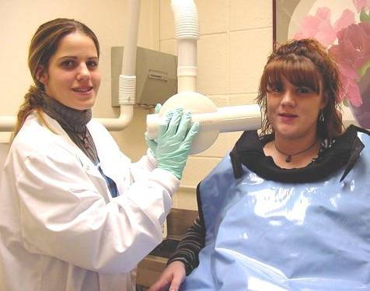
Auto Body
WE offer 17 technical areas to our students
Graphic Arts
Marine Services
Cosmetology
Plumbing
Horticulture
Culinary
Auto Tech
HVAC
Welding
Early Childhood
Carpentry
Info Tech
Business Management
Health Tech
Electrical
Dental Assistant

Slide 7
Academic Programs
Academic programs follow, where appropriate, in course the State Frameworks and Learning Standards. Other programs follow state and/or national and industry standards.
These Programs are:
English Language Arts
Mathematics
Science
Spanish
Social Studies
Academic Support
Computer Applications
Physical Education
Health
Shop Theory

Slide 8
What are our goals?
Our Mission Statement
Cape Cod Regional Technical High School will
provide an opportunity to acquire
high quality technical, academic and social skills
which prepare our students for success in our changing world.

Slide 9
2011-2015 CCT Strategic Plan
Goal 1
Improve Student Achievement, specifically including College and/or Career Readiness.
Goal 2
Improve the staff’s ability to provide instruction and support services that will improve Student Achievement.
Goal 3
Improve Public and Community Relations.

Slide 10
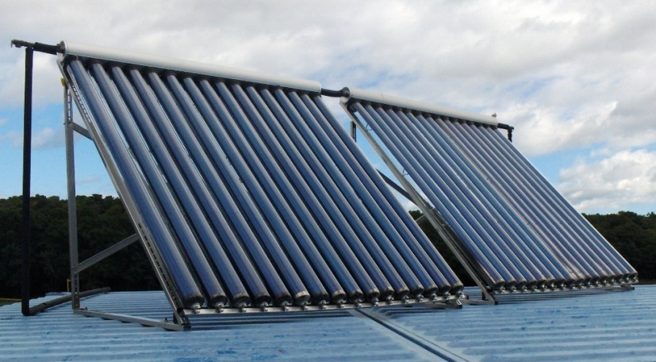
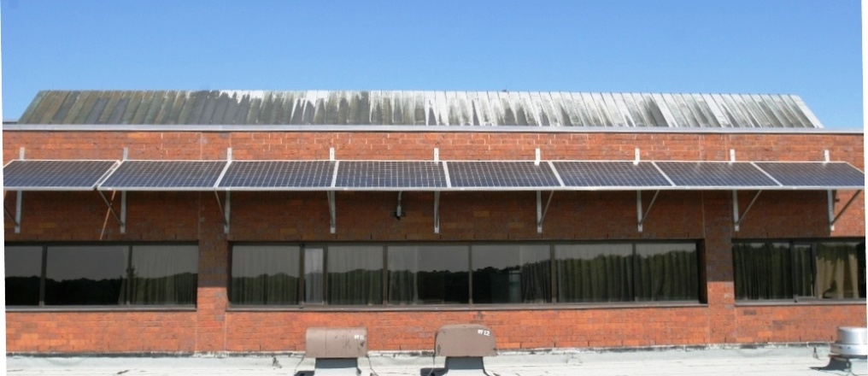
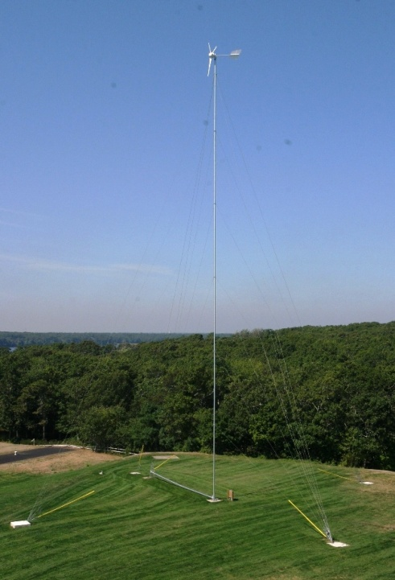
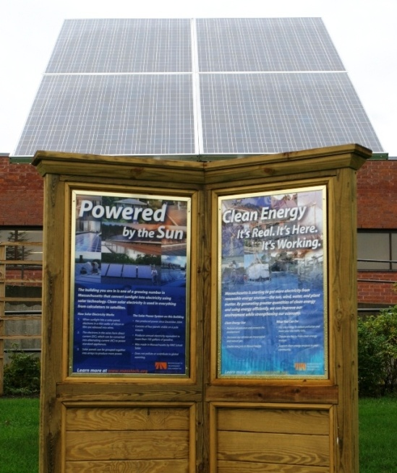
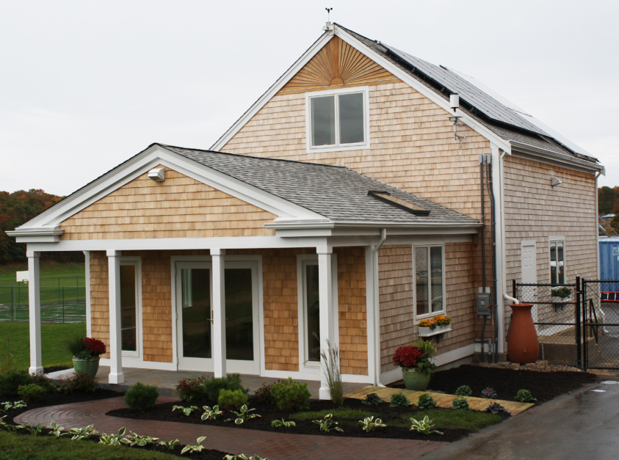
What are our opportunities?
Continue our leadership role in renewable energy

Slide 11
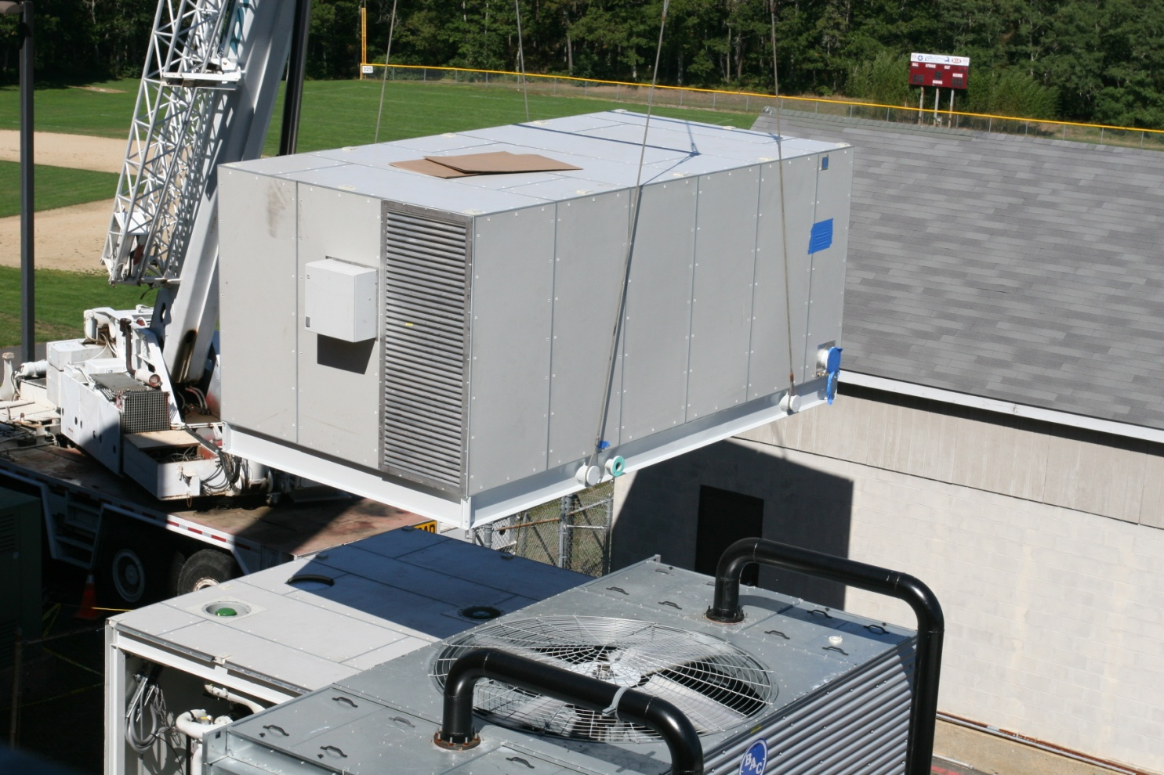
Tri-Generation System

Slide 12
Question: What is Tri-Generation?
Answer:
A unit, powered by Natural Gas, that produces electricity and captures the waste heat to offset heating expenses in the winter and cooling expenses in the summer.
Gas in
CHP Unit
Power in
Cape Cod
Tech
Waste
Heat
Absorption Chiller
Cooling
Heat
Dump
Oil or Gas in
Boilers

Slide 13
What are our opportunities? (cont.)
Competition
Expanding our offerings Health Technologies and Information Technologies
Emphasizing the benefits of a hands-on, competency-based, relevant education that always answers the question for our students; “Why do I need to learn this?” (Pathways to Prosperity)
Tapping the expertise and financial resources of industry partners where appropriate

Slide 14
What are our challenges?
State and local funding
Continuous improvement of our academic and technical offerings in support of our three strategic goals
Transitioning to mandates of Race to the Top (RTTT)
Competition from parochial, charter and school choice options
A declining student population on Cape Cod especially within our sending districts
FY05 5,919 in grades 5 – 8
FY11 4,598 in grades 5 – 8
A 22.3% decline in six years!

Slide 15
How can we collaborate for the benefit of both CCT and CCTC?
Become an advisory Committee member
Offer work experience to our students through our internship and cooperative education programs (Contact: Gary Lombard 508-432-4500 Ext. 312)
Become a Senior Project Mentor or presentation judge (Contact: Kate Clemens 508-432-4500 Ext. 342)
Senior project presentations to be held May 11-12!
Have a future meeting at our school with a tour.
Suggest possibilities for future collaboration

Slide 16
What about our IT technical area?
Lead Teacher – Larry Souza (508-432-4500, Ext. 311)
The IT program offers training in:
PC repair
LAN/WAN networking technologies
web development & programming.
A+, Net+ certifications
Serving as technicians, web developers and programmers for the school. The IT shop runs a full service help desk for employees and students and a carry-in service center for the public
For more information take a peek at the student developed IT Website at http://www.infotechshop.net/

Slide 17
Q & A in both directions?
What will be the most important effects of the OPEN CAPE initiative?
What enhancements to our information technologies technical area would you suggest to increase the employability of our students?
What is the cloud and how do you see it transforming education?

Slide 18
Thank you for your time and interest!
For more information, please contact me at the school
Robert P. Sanborn III
(508) 432-4500 x 214
rsanborn@capetech.us
Or visit our website at www.capetech.us

